Slide 1

Warm Up: Predict Blood Donations
07/14/2018
Midterm Project
Name: Young, Brent
DrivenData Name: bdy3176
MSDS 454 Section #: 55
Quarter: Summer 2018

Slide 2

Agenda
Recap of Problem
Data Exploration
Data Mining/Cleaning
Data Visualization
Application of Tools
Performance/Accuracy
Conclusion
Future Work/Learnings

Slide 3
Recap of Problem
Objective: Predict the probability that a donor made a donation in March 2007 using information about each donor’s history.
Original Dataset:
Response Variable
Made Donation in March 2007
4 Predictor Variables
Months since Last Donation
Number of Donations
Total Volume Donated
Months since First Donation
Training Dataset: 576 Records
Test Dataset: 200 Records
Notes:
Classification response variable of whether a person made a donation in March 2007 (1 = Yes, 0 = No).
Months since Last Donation: this is the number of month’s since this donor's most recent donation.
Number of Donations: this is the total number of donations that the donor has made.
Total Volume Donated: this is the total amound of blood that the donor has donated in cubuc centimeters.
Months since First Donation: this is the number of months since the donor's first donation.

Slide 4
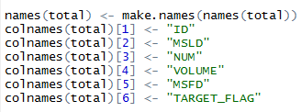
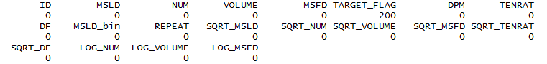
Data Mining/Cleaning
Combined Train and Test
Split the data into a 48/26/26 train/validation/test
376 training observations (48%)
200 validation observations (26%)
200 test observations (26%)
Cleaning
Added ID to help identify distinct records
Renamed variables to TARGET_FLAG, MSLD, NUM, VOLUME, and MSFD
No missing values, except NA’s in test set
Outliers were not removed

Slide 5
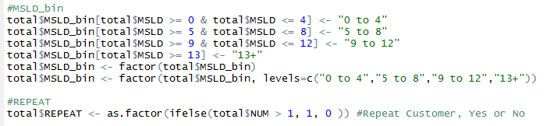
Feature Engineering
Feature Creation
DPM: Donations per Month
TENRAT: Ratio of Months since Last Donation to First Donation
DR: Donation Frequency
MSLD_bin
REPEAT: Identifies repeat donors
Transformations
SQRT: MSLD, NUM, VOLUME, MSFD, TENRAT, and DF
LOG: NUM, VOLUME, and MSFD
All numeric variables standardized to mean of 0 and standard deviation of 1 (Note: conducted after EDA)

Slide 6
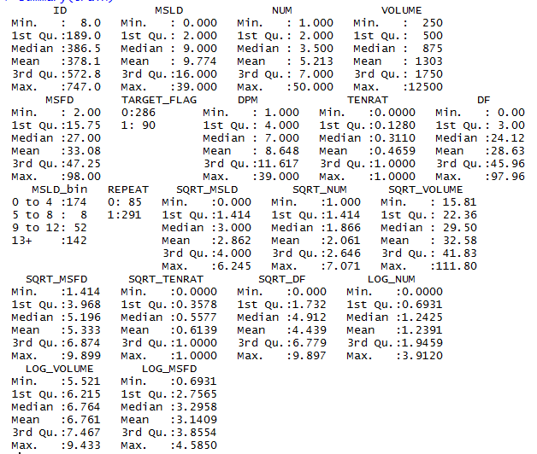
Data Visualization
Descriptive Statistics of Training Dataset

Slide 7
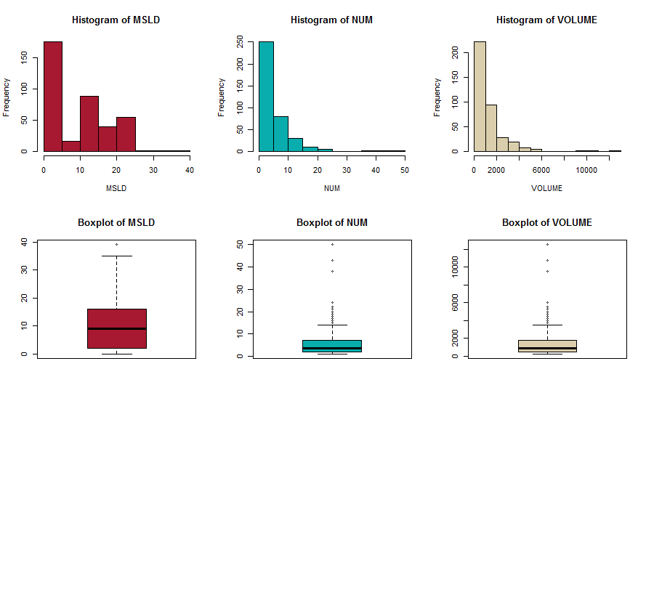
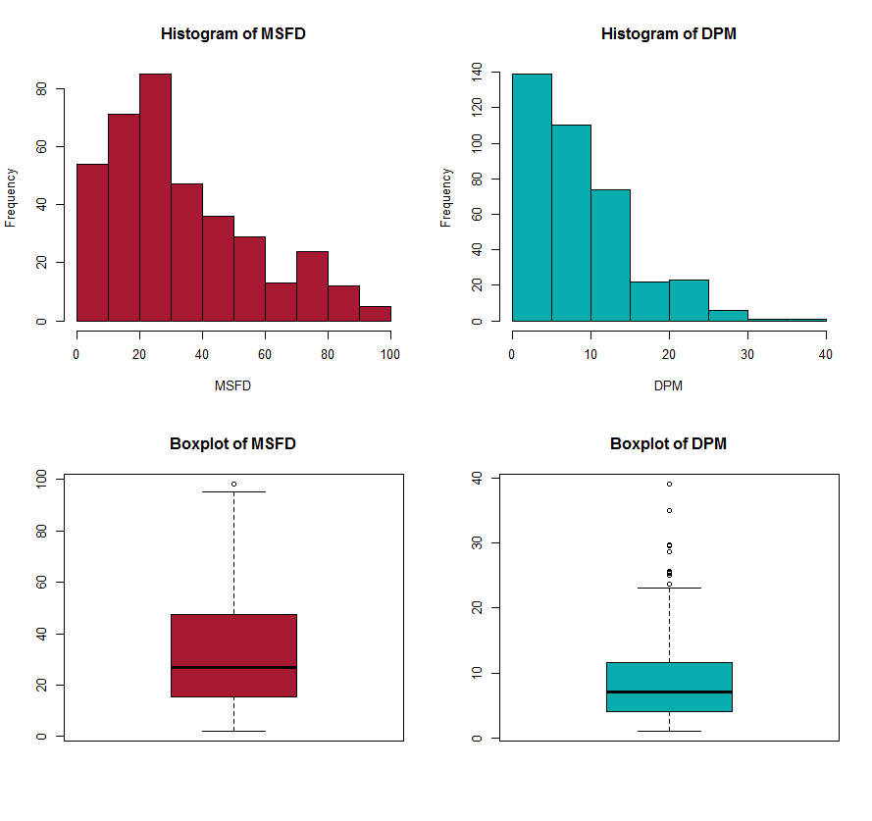
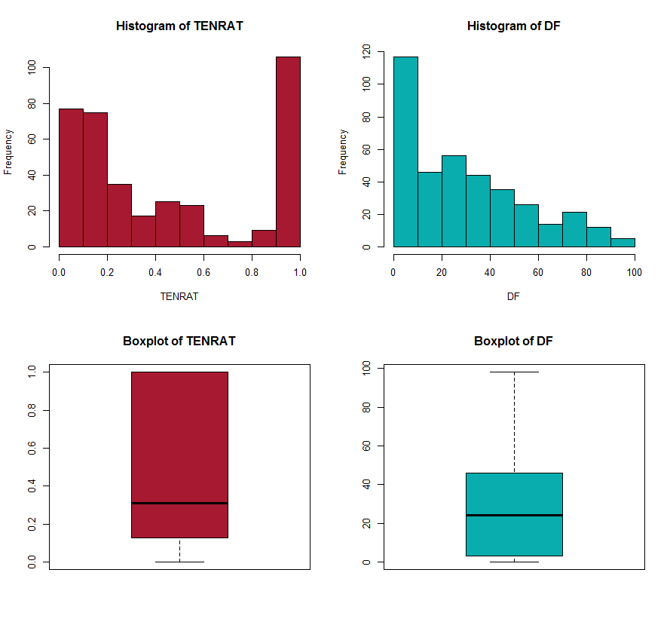
Univariate Plots
Average MSLD is 10, NUM is 5, VOLUME is 1303, and MSFD is 33

Slide 8
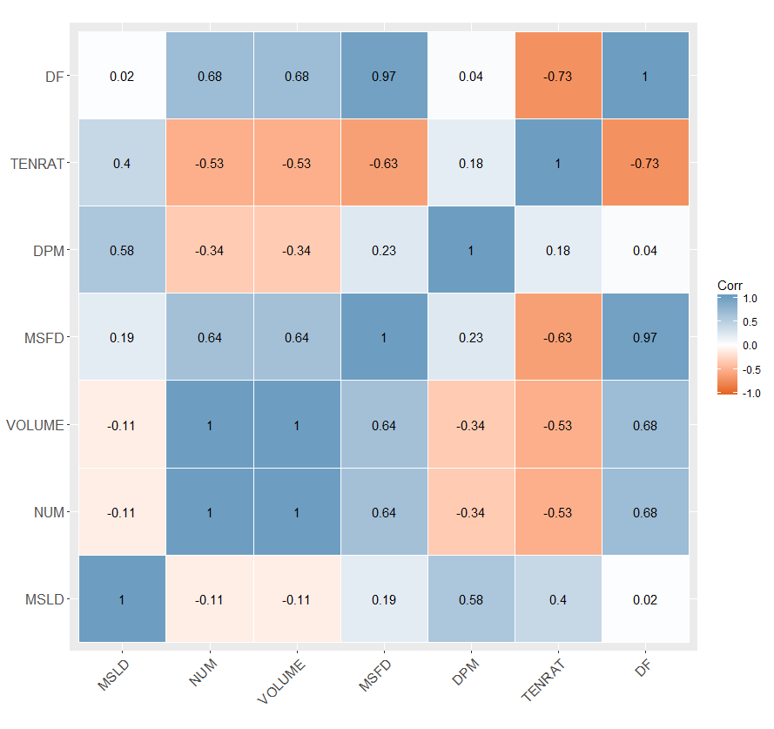
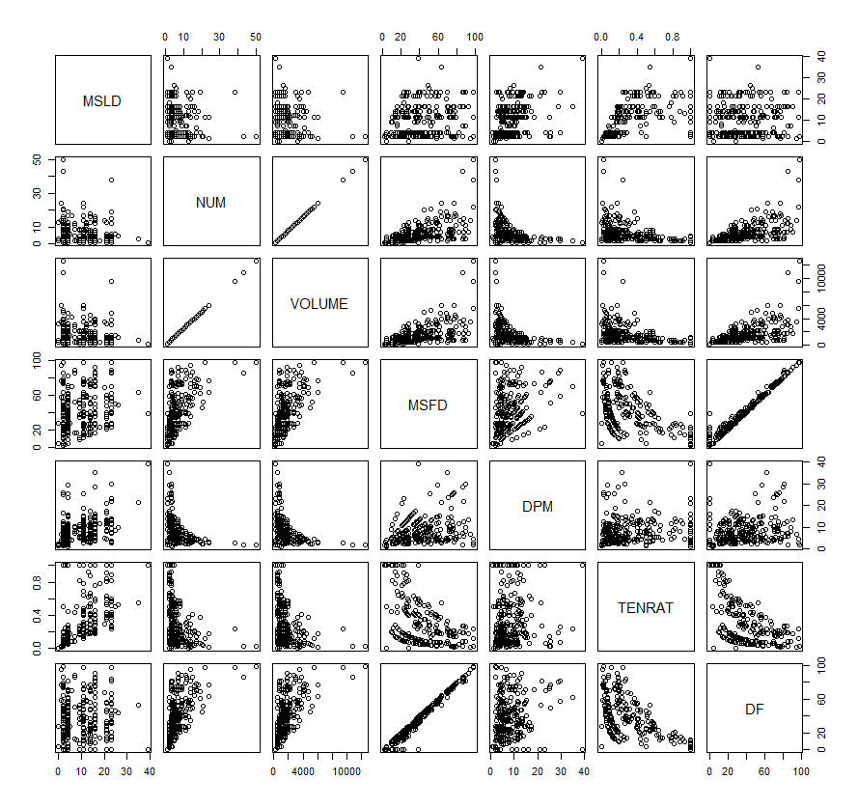
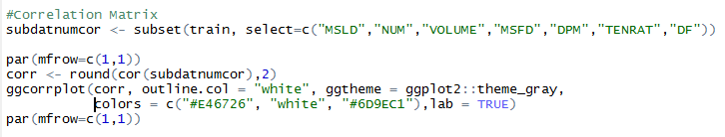
Correlation Plots

Slide 9
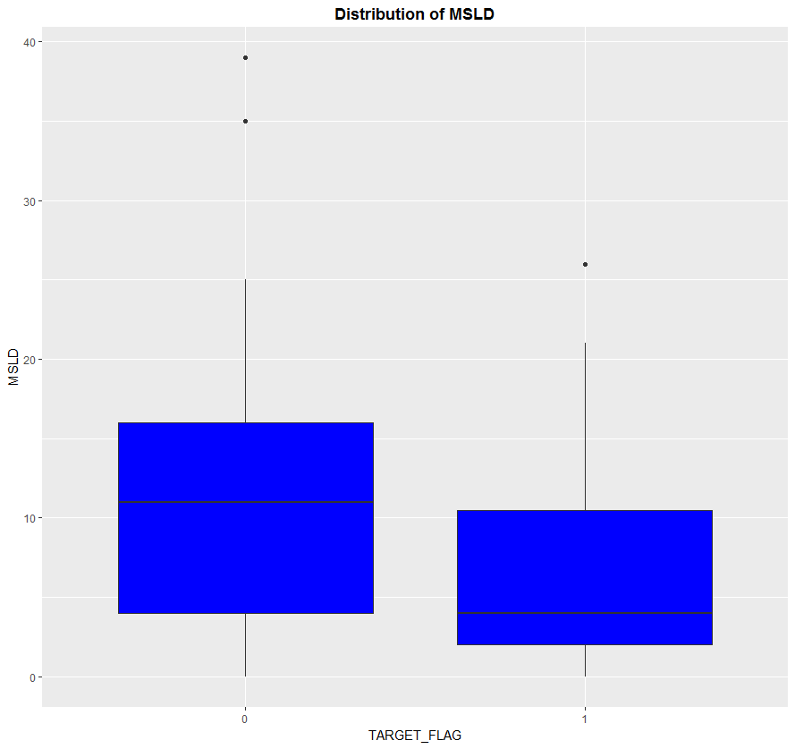
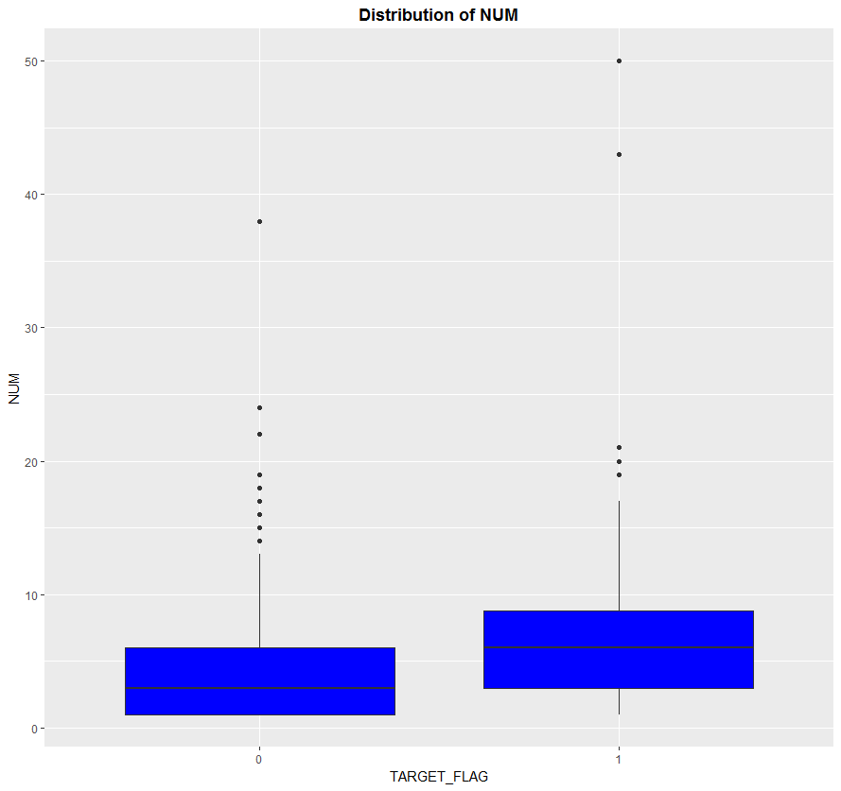
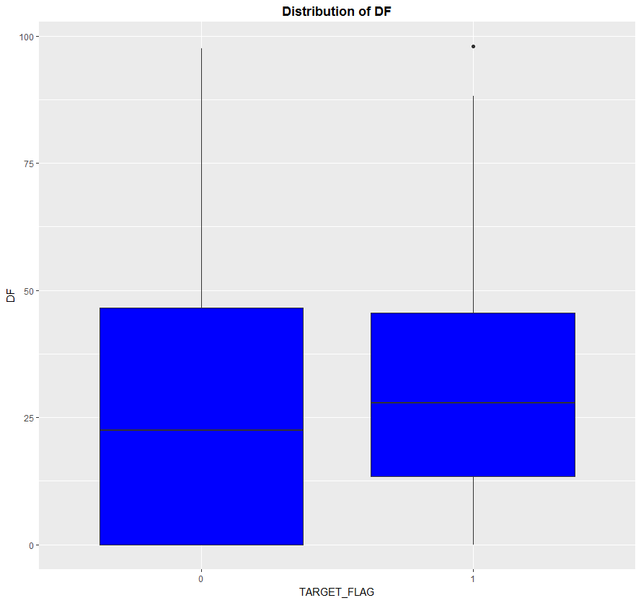
Multivariate Plots

Slide 10
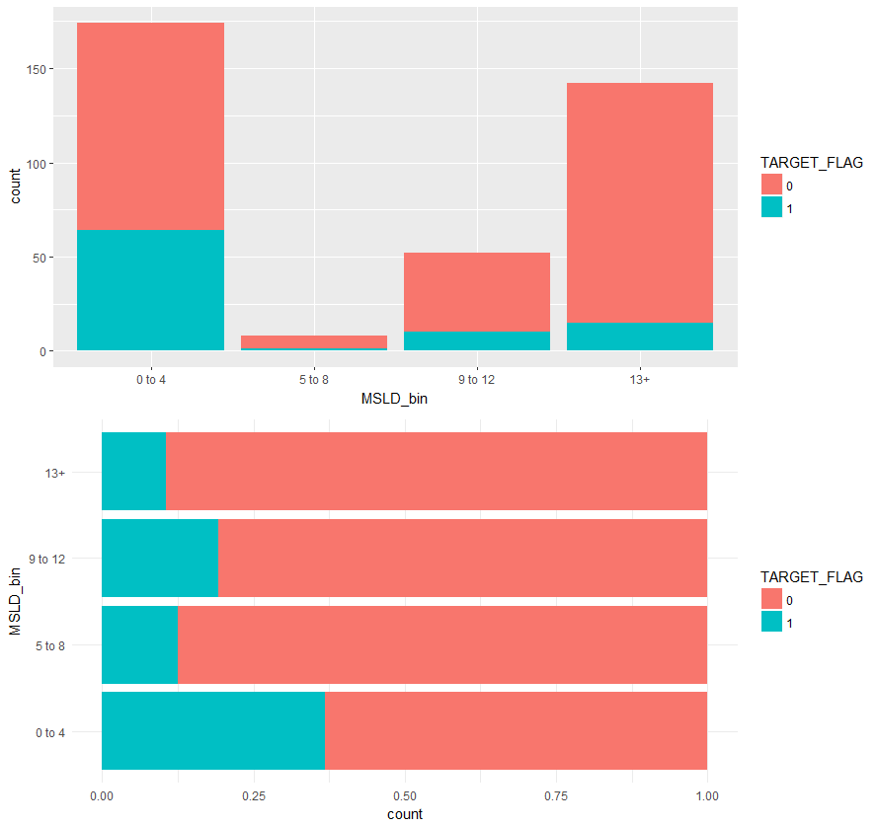
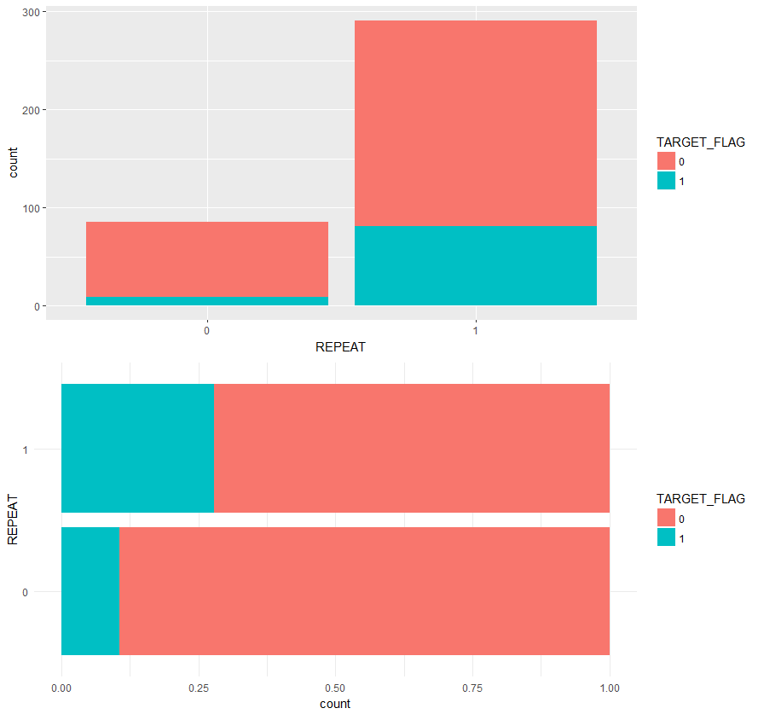
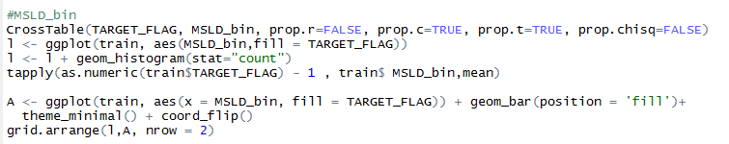
Multivariate Plots
MSLD_bin
REPEAT

Slide 11
Application of Tools
Logistic Regression
Linear Discriminant Analysis
Quadratic Discriminant Analysis
Decision Tree
Bagging
Random Forest
Gradient Boosting Machines
Neural Network

Slide 12
Performance/Accuracy
Validation Set
Model Name | Accuracy | AUC | LogLoss
Logistic Regression | 0.77 | 0.785636 | 0.4609
Linear Discriminant Analysis | 0.77 | 0.785636 | 0.4601
Quadratic Discriminant Analysis | 0.795 | 0.778372 | N/A
Decision Tree | 0.76 | 0.676124 | 0.5130
Bagging | 0.755 | 0.605743 | N/A
Random Forest | 0.78 | 0.683114 | N/A
Gradient Boosting Machines | 0.765 | 0.638706 | 0.4993
Neural Network | 0.77 | 0.787144 | 0.4579

Slide 13
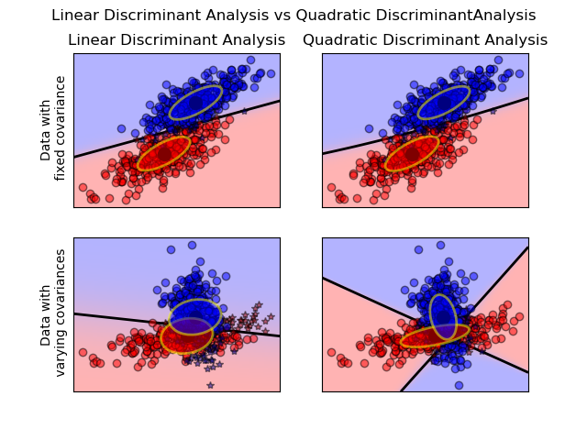
Quadratic Discriminant Analysis
Similar to LDA, in which the QDA classifier results from assuming the observations in each class are drawn from a Gaussian distribution and then Bayes theorem is applied to perform prediction.
However, QDA assumes that each class has its own covariance matrix and assumes a quadratic decision boundary.
Variables were chosen using the same variables from the logistic regression model (with stepAIC).

Slide 14
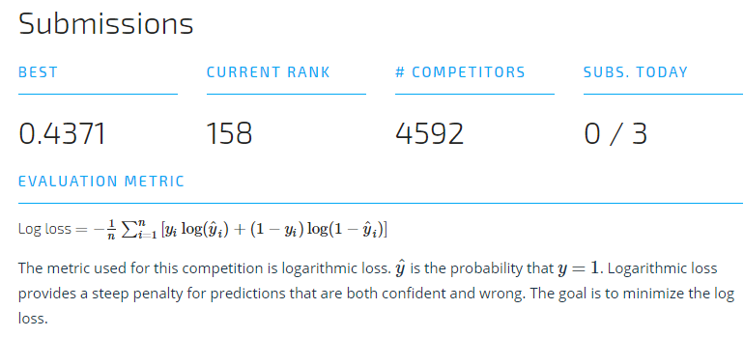
Performance/Accuracy
Test Set
As of 7/18/18

Slide 15
Conclusion: Future Work & Learnings
Future Work:
Obtain more data and variables:
Gender, age, ethnicity, education level, job status, job type, college/university, donation region/city
Climate/temperature variables
Income (individual and family/parents)
Average time spent waiting prior to donating at the university
Average dollars spent on advertising at the university
Explore different mixing of models; model averaging
Explore different transformations, interactions, other R packages
Primary Learning
Less sophisticated modeling techniques (e.g., GLM, LDA, QDA) can beat sophisticated ones (Bagging, Random Forest, GBM).

Slide 16
Thank you!

